Slide 1



Salesforce Presentation Group 4

Slide 2

summary
Salesforce is an American Cloud based Software Company.
It provides Customer Relationship management (CRM) software and applications focused on Sales, automation, and Analytics. The main objective of salesforce management is a strategy to increase business sales by doing analysis.
A Salesforce lead is a potential customer, potential sales contact, potential sales opportunity. Leads are generated in many ways like from existing customer, referrals, through web, through online advertisements, campaigns and direct customers. Lead management is one of the key Functionality to improve business.
A lead can be converted into a contact, an account, or an opportunity. To create an opportunity we've to consider few stages: contacted, working, unqualified, Converted and few parameters: lead's product interest, budget, timeframe.
Tools used: My SQL, MS Excel , Power BI, Tablue.

Slide 3


KPI list
Total Lead
Expected Amount from Converted Leads
Conversion Rate
Converted Accounts
Converted Opportunities
Lead By Source
Lead By industry
Opportunity KPI’s
Expected Amount, Active Opportunities,
Conversion Rate ,Win Rate, Loss ,Trend Analysis
Running Total Expected Vs Commit Forecast Amount over Time
Running Total Active Vs Total Opportunities over Time
Closed Won Vs Total Opportunities over Time
Closed Won vs Total Closed over Time
Expected Amount by Opportunity Type
Opportunities by Industry
Leads Kpi’s

Slide 4
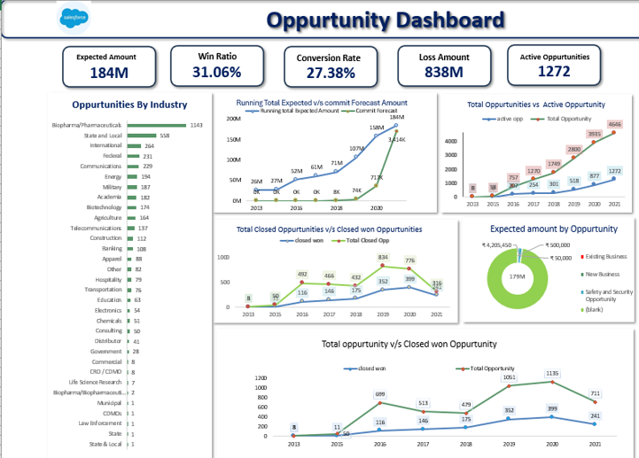
EXCEL Dashboard

Slide 5
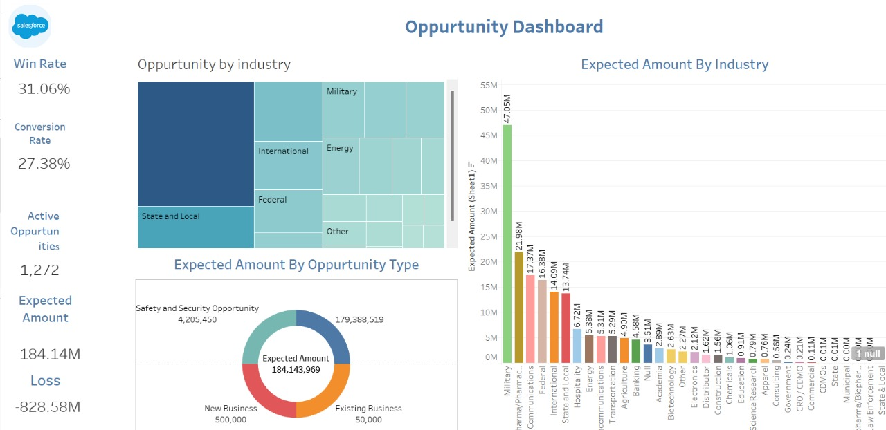
Tablue Dashboard

Slide 6
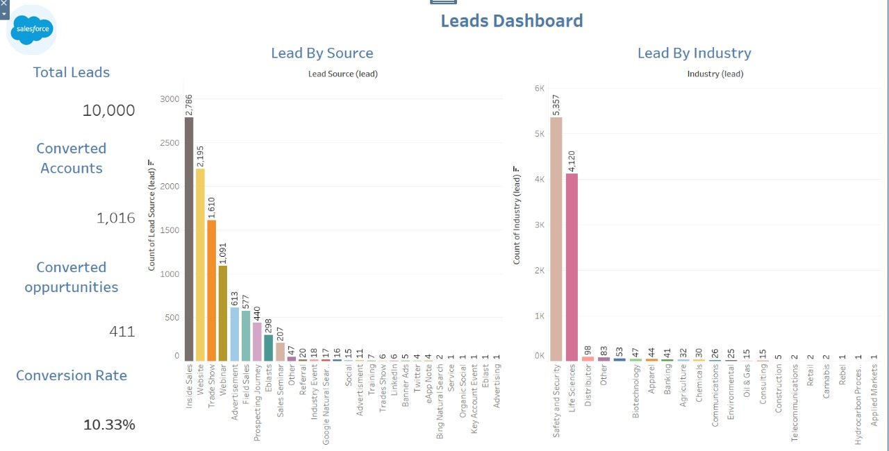
Tableue Dashboard

Slide 7
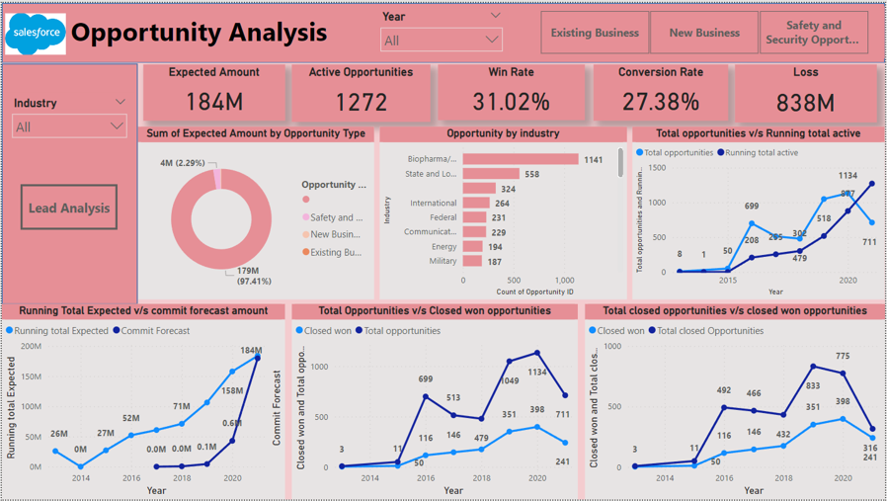
Power bi Dashboard

Slide 8
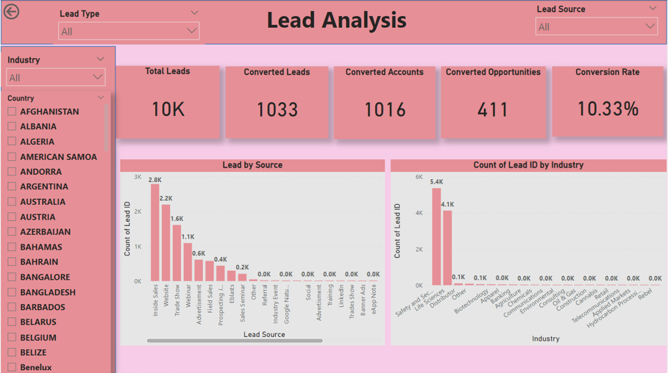
Power bi Dashboard

Slide 9
Key points
Lead Source
Status
Industry/Company Size
Lead Conversion Rate
Activity History
Opportunity
Sales Pipeline Progress
Revenue Forecasting
Timeline and Urgency
Strategic Decision-Making
Leads

Slide 10


team
Prajitha Nair P
Akansha Mohod
Akash pawar
Piyush Kolte
Swapnil Amrale
J Saneeth Reddy

Slide 11
Thank You

